Slide 1


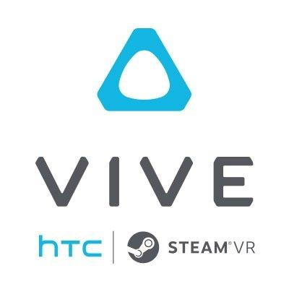
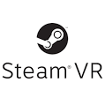
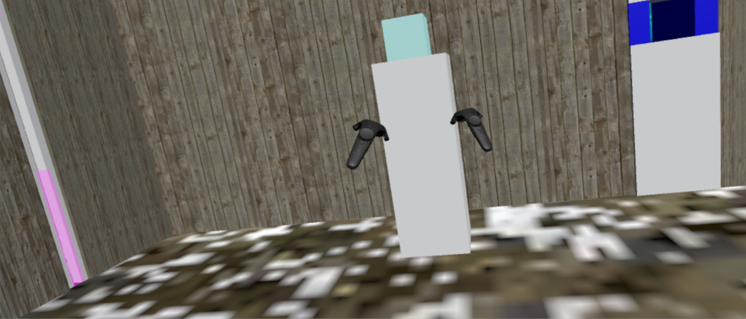
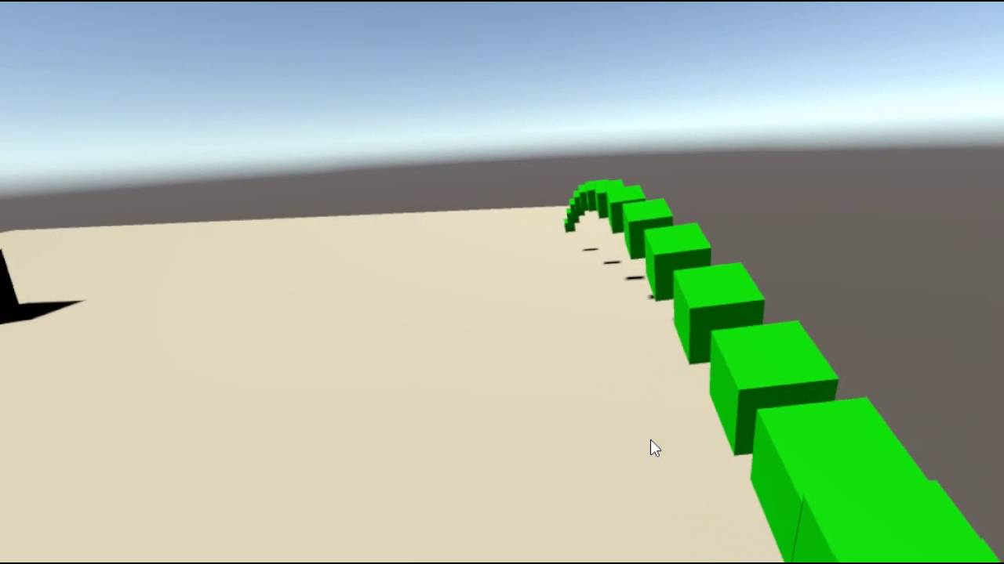
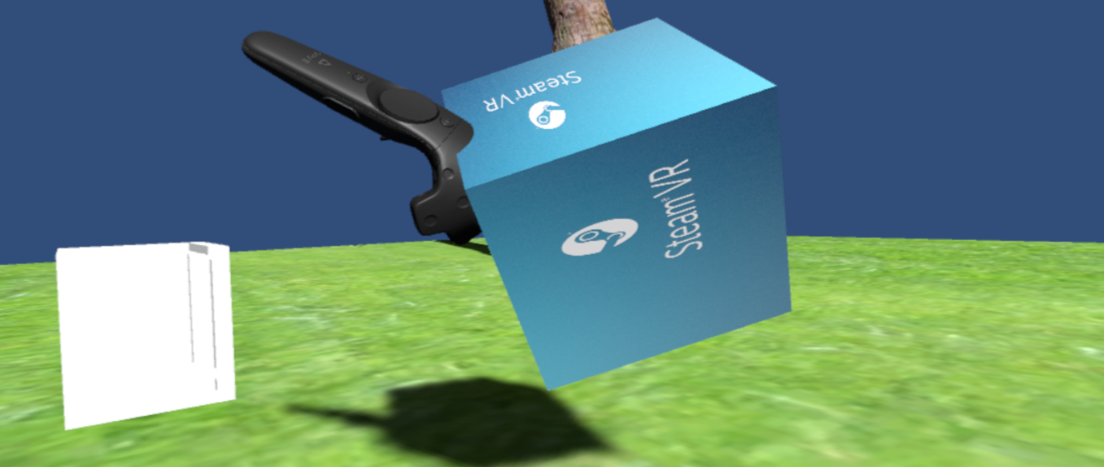
School of Computing & Information Sciences
Senior Project, 2016, Fall
VR Educational Framework
Student: Jacob Leschen, Florida International University
Mentor: Francisco Ortega, Mohsen Taheri, Florida International University
Instructor: Masoud Sadjadi, Florida International University
Problem
Originally designed to be a mode of implementation for an interactive painting software, we have decided to create a framework for Virtual Reality (VR) programs. The project, now aimed towards individual work, has the goal of building a framework for VR that can be used for educational programs. Taking advantage of the VIP design process, we would like to create a grounds for future programming that adheres to three main functions:
Uses VR Technology
Builds a framework for future iterations of projects
Can be used for educational purposes
Current System
Currently, the VR framework is in a completed state, ready to be iterated upon by a new generation of programmers. Features include:
1. Unity project that provides a base to create games within
2. Test showcase that can demonstrate physics and movement
Requirements
1. Framework that can be built upon using Unity engine
2. System that takes advantage of the HTC Vive headset/controller
Solution
Our implementation is a project that takes advantage of Unity and its associated plugins for VR games development. Our first iteration of the system uses the HTC Vive as our VR hardware, but plans for other devices are possible in future iterations.
1. Using HTC Vive, develop a prototype system within Unity
2. Create a framework that can be developed for educational purposes
3. SteamVR and Virtual Reality Toolkit (VRTK) plugins are used
(All work is the first version/iteration of this project)
System Design
Object Design
Implementation
1. Physics showcase with firing range and interactable objects
2. Maze game that takes advantage of movement and controls
Functions for Interactable Objects follow a unique sequence. The unity engine is aware of all actors in the system.
Class diagram of a Unity scene that uses the framework
Verification
Test Case 1: Pick up object
Purpose: Test to see if object framework can pick up object and track the controller
Preconditions: user has no other objects picked up
Action: User moves controller over the object’s model, presses the pickup button, then moves the controller
Expected result: Object should start tracking the controller’s movements: velocity, rotation, trajectory when the button is released.
Actual result: Same as Expected Result.
Test Case 2: Teleport
Purpose: Test to see functionality of teleportation as a mode of movement
Preconditions:
Case 1: User has no object picked up
Case 2: User has an object picked up
Action:
Case A: User holds the teleport button and points to a location where the pointer is red
Case B: User holds the teleport button and releases it when the pointer is green
Expected result: Case 1-A/2-A: Camera remains in place
Case 1-B: Camera teleports to location
Case 2-B: Camera teleports, object is dropped
Actual results: All as expected
Screenshots
Summary
The VR Framework, while having little to show off in its current implementation, provides an excellent base for future programmers to create educational Virtual Reality experiences.
Acknowledgement
The material presented in this poster is based upon the work supported by Jacob Leschen. I am thankful to the help that I received from my group members, Alain Galvan, Jose Morgan, Justin Alvarez.
Notes:
‹#›

